Slide 1


Amazon product analysis

Slide 2
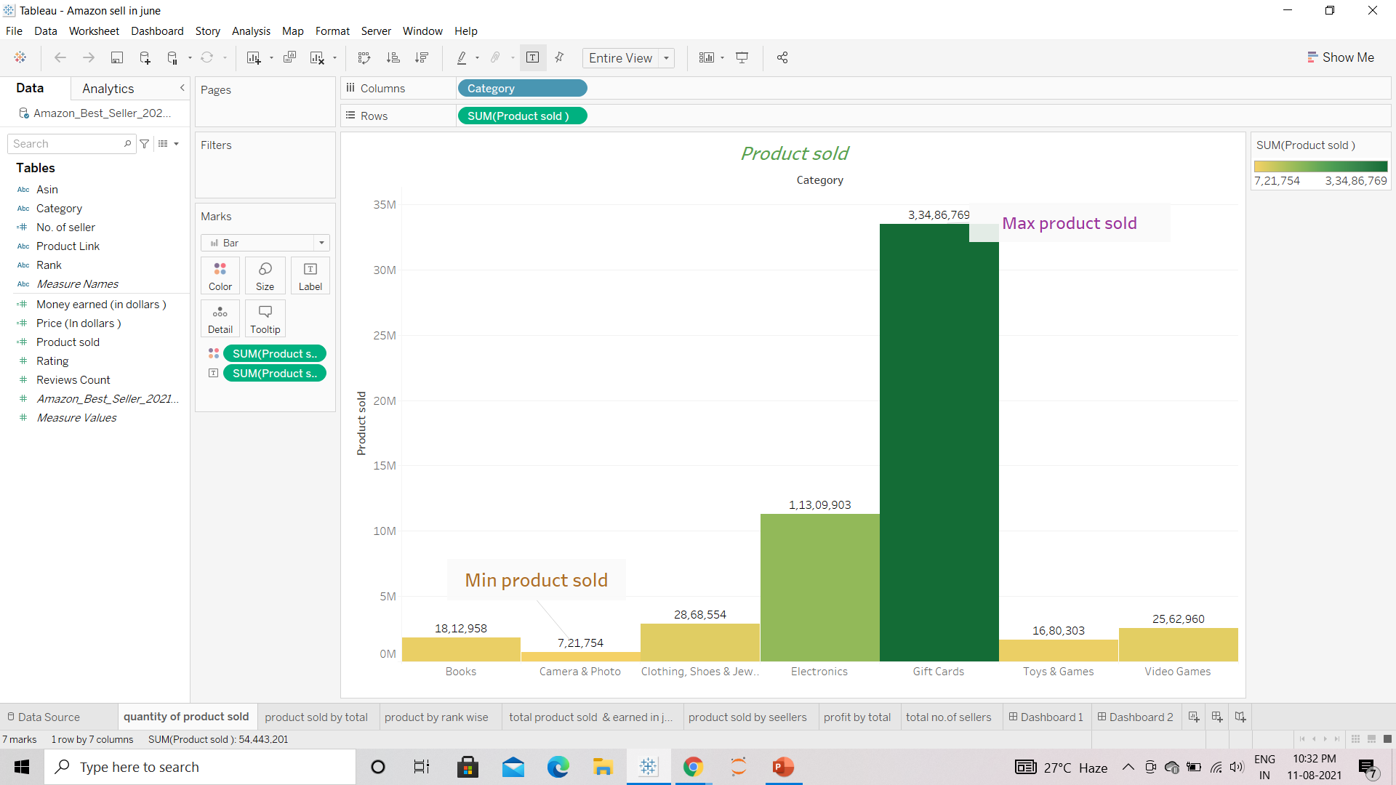
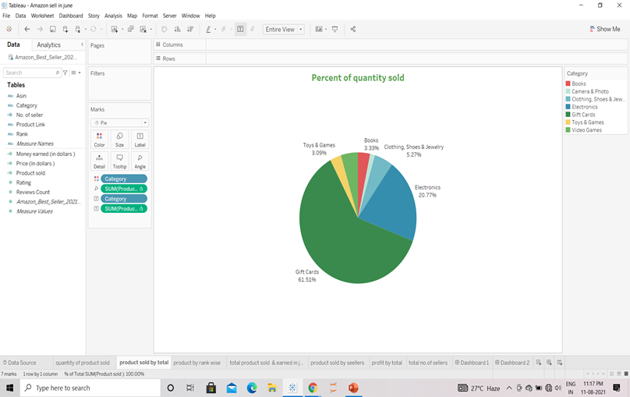
The product which sold in the month of June from amazon website consists of gaming category . Which is tremendously above 3 crore in number with dominating 61% of total product sold in month of June . (in the dark green colour)

Slide 3
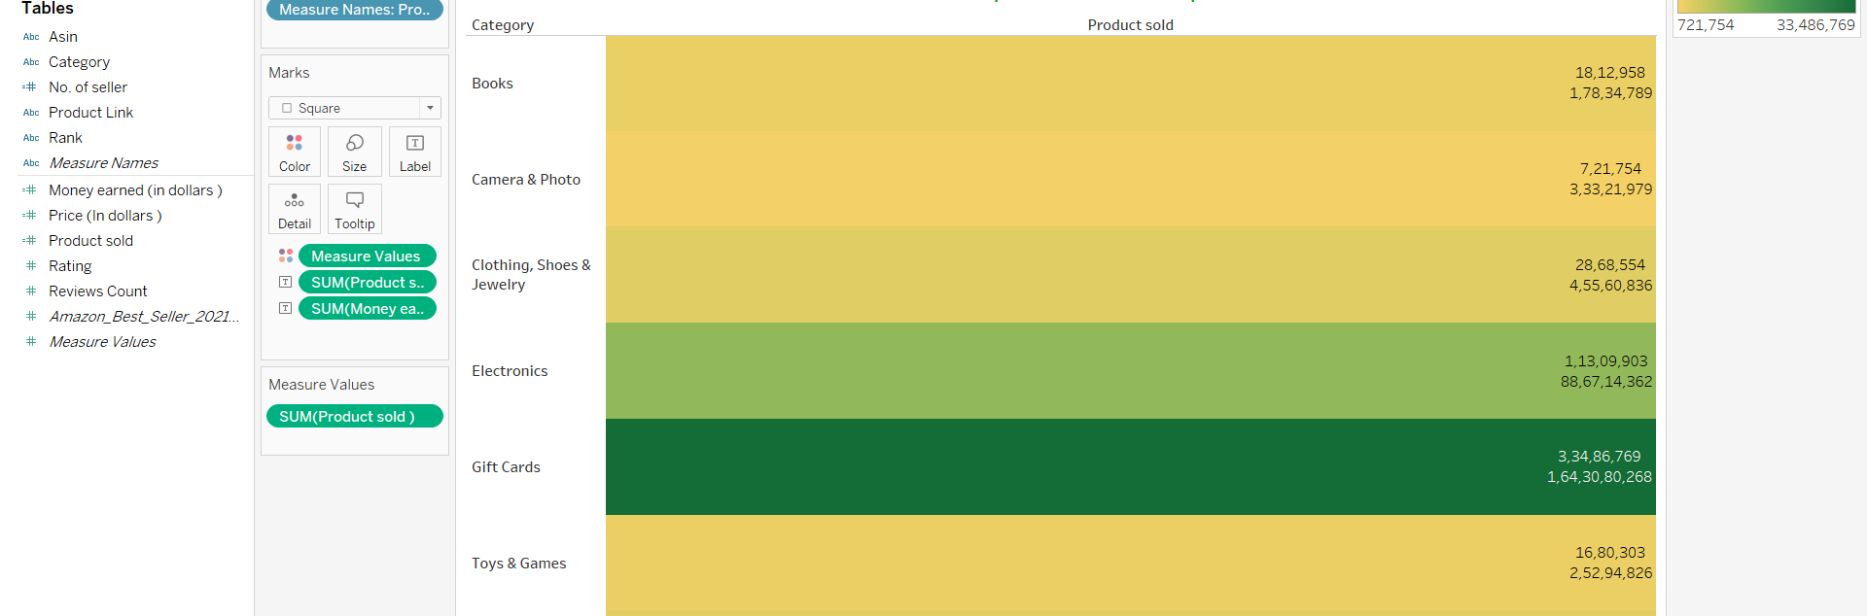
Total product sold and money earned with category wise
Least subcategory product sold is book with only 18+ in number .

Slide 4
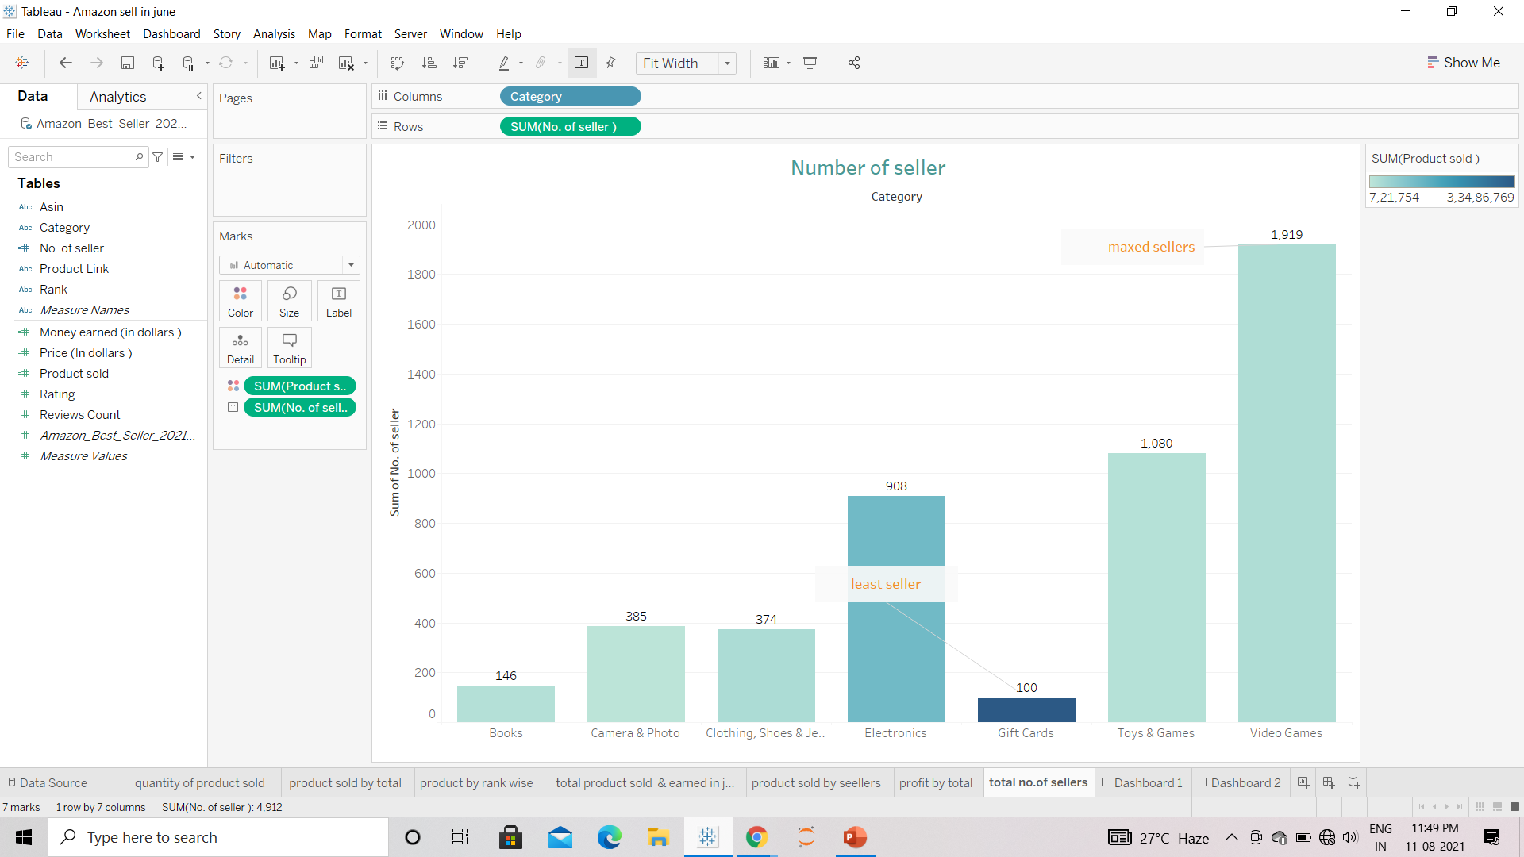
In context to total no. of sellers, video game is dominating with around 1000+ and gift with least having only around 100.

Slide 5
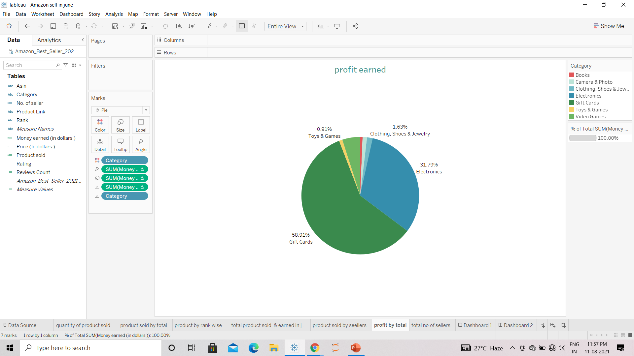
Contradictory gift is only category of product which is giving maximum amount of earning with 2/4 of chart (59% approx.)

Slide 6
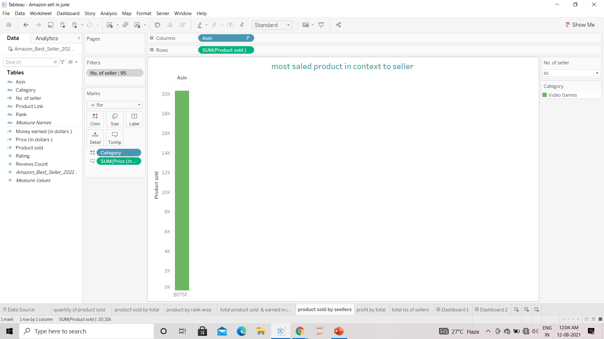
Product no. BO7SFKTLZM with 95 seller from video games category

Slide 7
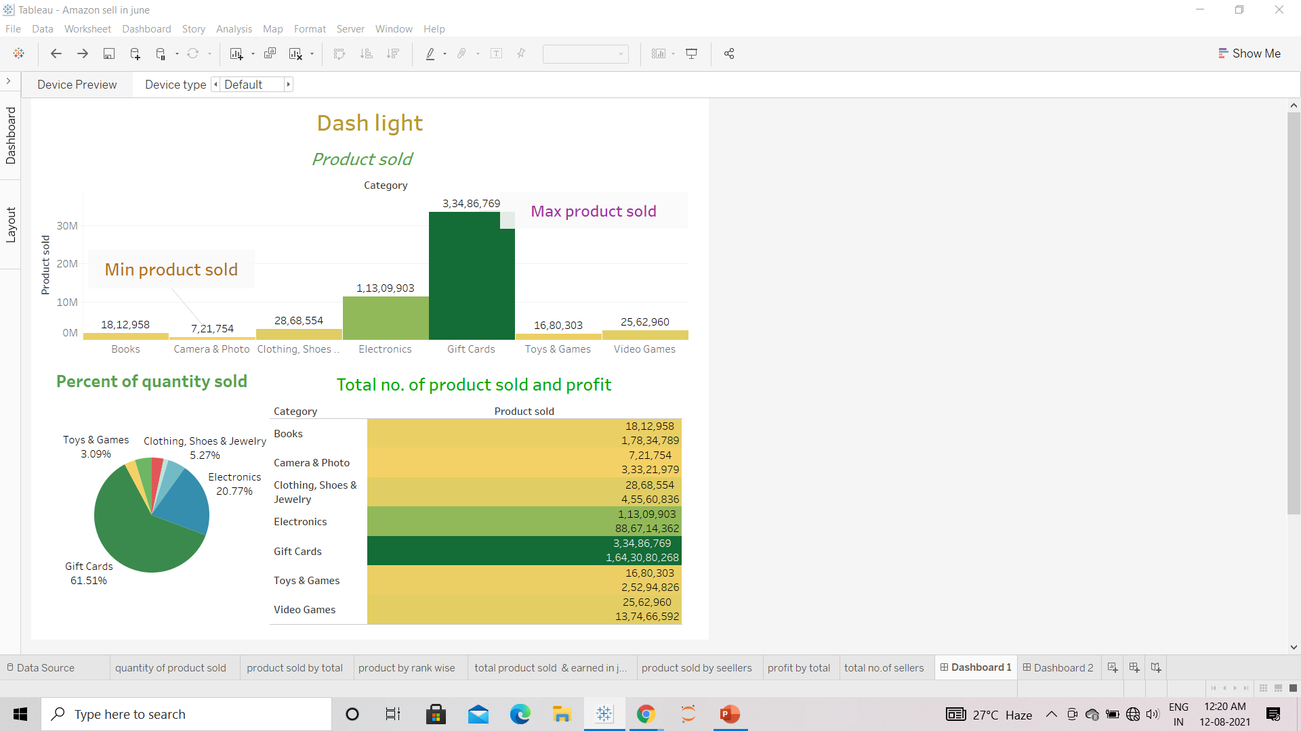
Conclusion
We need to gather more number of seller of the gift card from category .As giving above 59% of total sells .
Cheapest product are from gift card category .
Least items where sold from camera and photo category .
Least earning was generated from book category .

Slide 8


